Slide 1
Multiple Files Upload
Author: Cong Le Van

Slide 2


SYSTEM ARCHITECTURE
Frontend: Reactjs
Backend: Java Spring Boot
Database: MySQL
Axios
HTTP
Library
MySQL
Routers
Components
Services
Spring
Rest
Controller
Spring
Data JPA

Slide 3
Backend
Filename: backend-upload-files
Technology
Java 8
Spring Boot 2
MySQL Database
Maven 3.6.1
How to run:
We used to spring-tool-suite-4 to run backend
Before running,Create database database_upload_files using mySQL Workbench

Slide 4
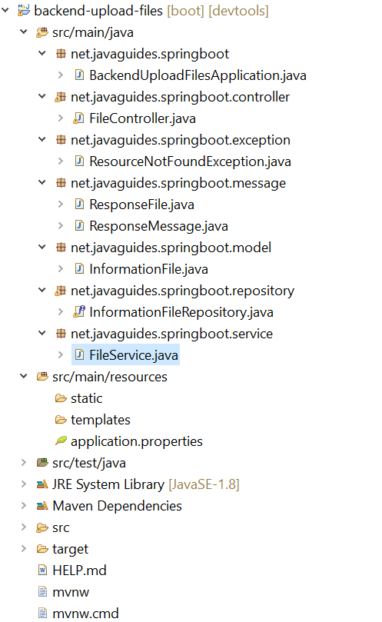
Backend-source code
Structure Code
Define controller for upload file
POST /files: uploadFile()
GET /files: getListFiles()
GET /files/{id}: getFile()
DELETE /files/{id}: deleteFile()

Slide 5
Frontend
Filename: frontend-upload-files
Technology
React 17
Axios 0.21.1
Bootstrap 5
How to run:
Import code to visual studito code
Command to install library : npm install
Command to run app: npm start

Slide 6
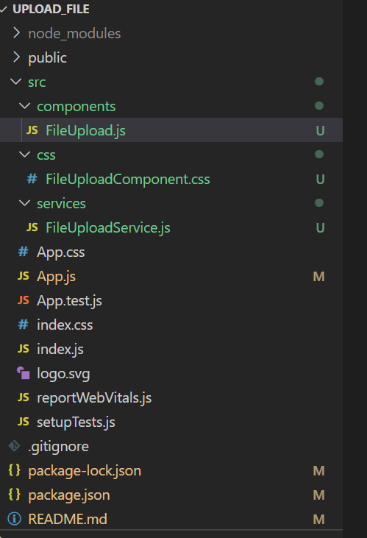
Frontend-source code
Structure Code
Web API for File Upload & Storage
Here are APIs that we will use Axios to make HTTP requests:
Methods | URL | Actions
POST | /files | Upload a file
GET | /files | Get list files
GET | /files/{id} | Get a file
DELETE | /files/{id} | Delete a file

Slide 7
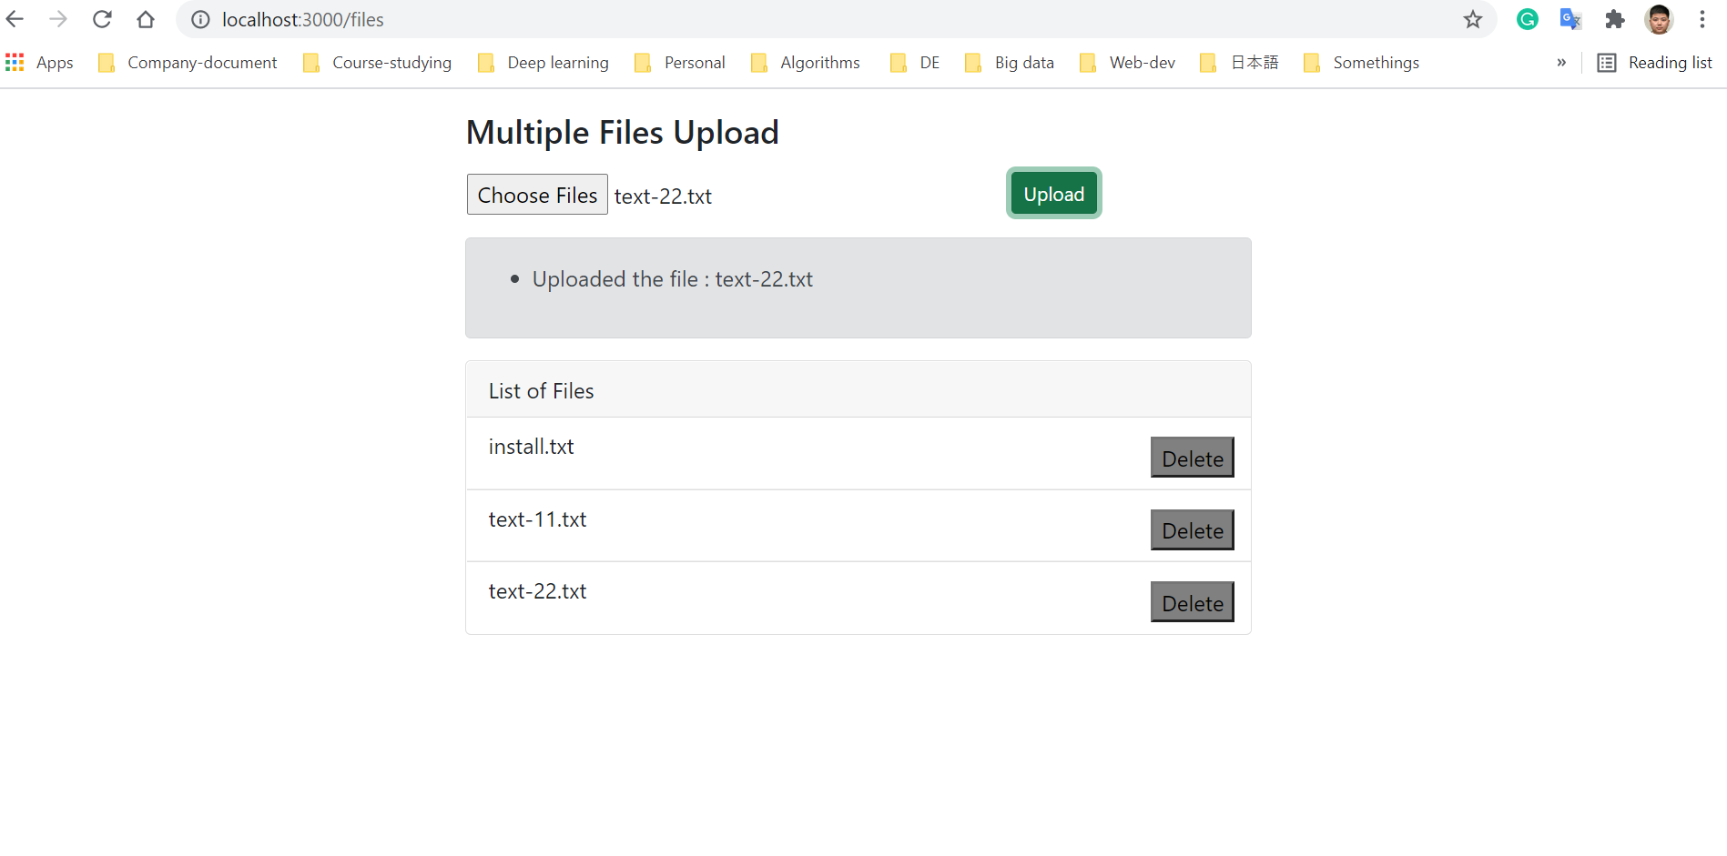
Demo App
Upload and List file

Slide 8
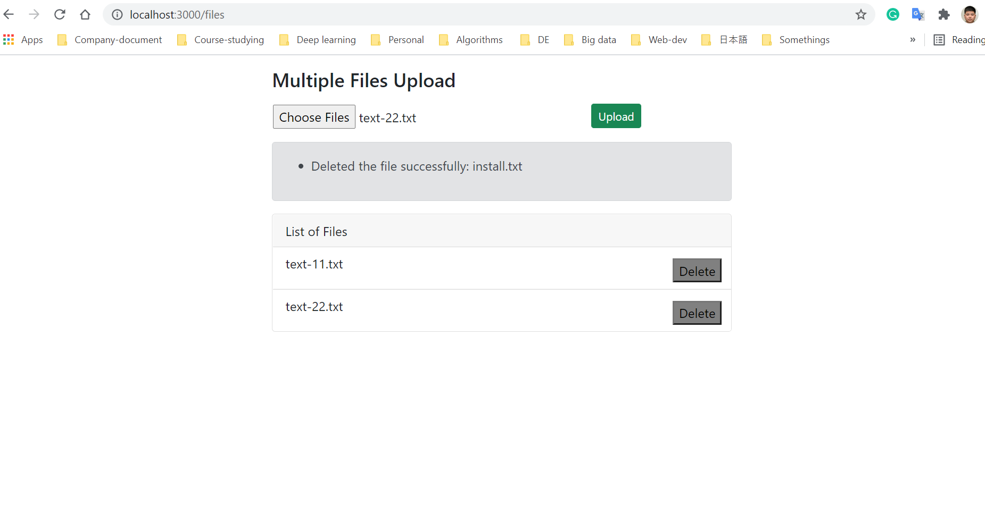
Demo App
Delete file

Slide 9
THANKS FOR READING

